Slide 1
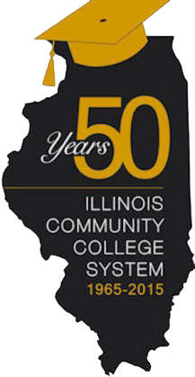
Illinois Community College System
Not What It Use to Be!
Dr. Karen Hunter Anderson

Slide 2
History of the Community College Movement in Illinois
1901
1943
1955
1937
Junior College Act becomes law
Joliet Junior College is established
1st public junior college in the nation
Development of junior college system as part of public school system
Legislation is adopted to hold referenda to set tax rates to support junior college operations
1959
1965
1973
1990
2016
State funding for junior colleges is first appropriated
Separate junior college districts with an elected board were authorized
Junior College Act of 1965 is adopted (July15th)
This is the foundation of today’s community college system
Illinois Community College Board is established
The term “junior” is changed to “community” in state law
The entire state is included within community college district boundaries
48 community colleges in 39 districts (3rd largest in the nation)
Statewide economic impact of $3.1 billion
Graduates can expect a lifetime earnings gain of $570,000

Slide 3
From “Junior” to “Community” College
Terry Bruce
CEO, Illinois Eastern College
Vice Chairman, Illinois Community College Board

Slide 4
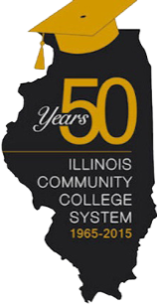
Illinois Community College System
THEN
NOW

Slide 5
Illinois Community College System Programs
THEN
NOW
Baccalaureate Oriented Courses Account for Roughly ¾ of all Course Offerings in 1960’s
Limited Occupational Program Offerings
(Only 266 total programs in 1966)
Programs include: Key Punch Operations, Bookkeeping, Woodworking, & Metalworking
22 of 34 Colleges Offer Programs Cooperatively with Business & Industry
Baccalaureate Oriented Courses Account for Roughly ½ of all Course Offerings
Wide Variety of CTE/Vocational Program Offerings
(Over 615 new programs add in 2016 alone)
Programs include: Proton Therapy, Nanotechnology, Unmanned Aircraft Systems & Sustainable Design
All 48 Colleges Offer Programs Cooperatively with Business & Industry

Slide 6
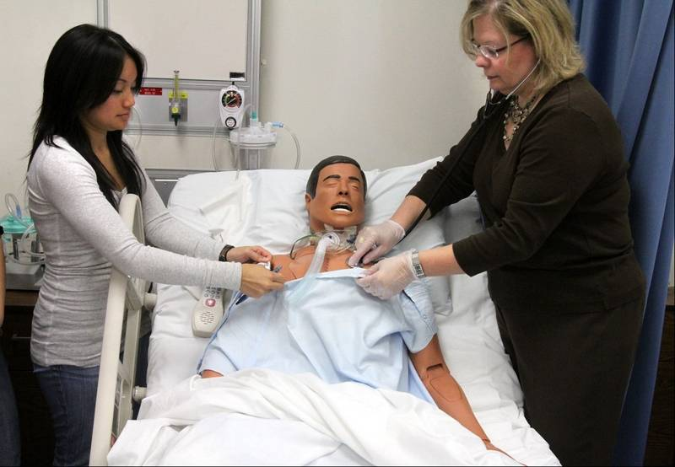
Illinois Community College System Programs
THEN
NOW
Notes:
Lakeland – 1960’s Science Class
Oakton – Nursing Lab

Slide 7
Illinois Community College System Programs
Mike Monaghan
Executive Director, Illinois Community College Trustees Association

Slide 8
Illinois Community College System Students
THEN
NOW
Fall Enrollment is 62,466 in 1966
60,000 Students Annually Enrolled in Non-Credit Courses in 1969
Popular Programs: Academic Refresher Courses and Stock Market
Community College Completions are 12,023 in 1971
Tuition in 1967 Averages $4.00 Per Credit Hour
Fall Enrollment is 316,155 in 2015
182,000 Students Annually Enrolled in Non-Credit Courses in 2015
Popular Programs: Culinary Arts and Personal Enrichment
Community College Completions are 71,787 in 2015
Tuition in 2016 Averages $125.37 Per Credit Hour

Slide 9
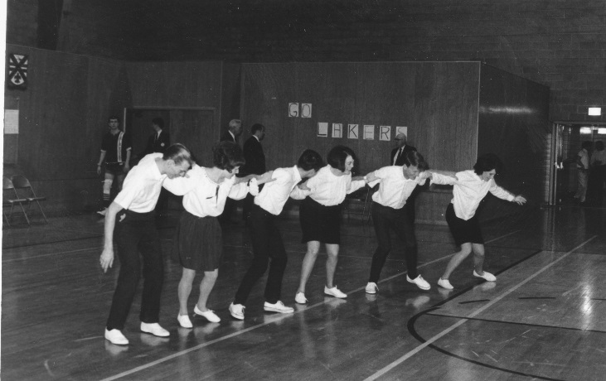
Illinois Community College System Students
THEN
NOW
Notes:
Pictures:
Elgin - Community Education Hat Making Class
Lakeland - Gym 1969
Lincoln Land – Community Education Crockpot Cooking
City Colleges – Student Government Association

Slide 10
Illinois Community College System Students
Peg Lee
President (1995-2015), Oakton Community College

Slide 11
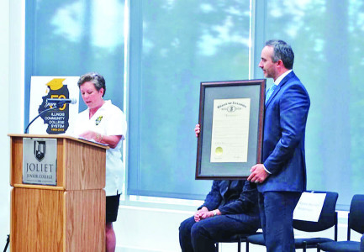
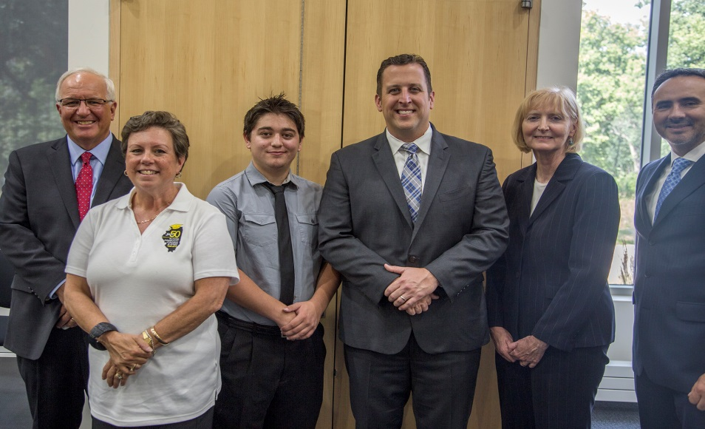
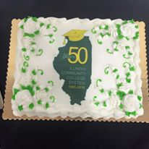
Year of the Community College
Governor Rauner proclaims July 15, 2015 through July 15, 2016 as “The Year of the Community College” in honor of the system’s 50 years of student success.

Slide 12
50 Years of Excellence
Charlotte Warren
President, Lincoln Land Community College

Slide 13
50 Years of Excellence
Terry Bruce
CEO, Illinois Eastern College
Vice Chairman, Illinois Community College Board

