Slide 1
STRENGTHENING COLLABORATIONS TO IMPROVE STUDENTS ACCESS TO RESOURCES
KAREN CALDWELL LITTLETON Wellness Center Clinical Director Title IX Confidential Advisor SUHA JARAD Career Development Center Caseworker Benefits Navigator

Slide 2
GETTING THE WORD OUT
Faculty Development Week
Classroom Visits
Flyers
Student Referrals
Close Network of Colleagues

Slide 3
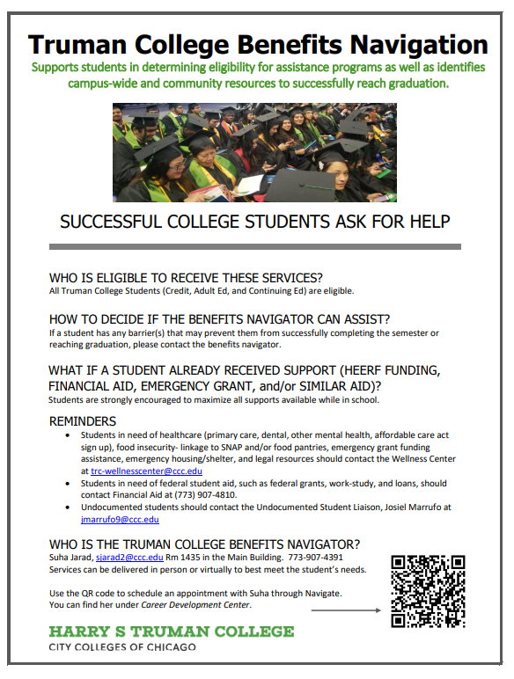

Slide 4
BENEFITS NAVIGATOR DUTIES
Support students in determining eligibility for assistance programs as well as identify campus-wide and community resources to successfully reach graduation.
SCHOLARSHIPS Future Ready Gateway CELWS Partners in Education | LENDING LIBRARIES Cosmetology Early Childhood Education | DONATIONS Gift Cards/food boxes Rent Clothes Furniture & home supplies
GRANTS WIOA Perkins Seniors | MEDICAL SUPPORT Financial assistance Schedule doctor appts | MISCELLANEOUS Waivers Ventra U-Pass IT

