Slide 1

Illinois Higher Education Information System
Annual IHEIS Webinar
December 11, 2024

Slide 2
IHEIS Collection Schedule
2024-2025 Illinois Higher Education Information System
Data Collection | Open Date | Close Date
Fall Enrollment Survey Pt I | Friday, September 6, 2024 | Friday, October 4, 2024
Fall Enrollment AY 2024-2025 | Monday, February 3, 2025 | Friday, March 21, 2025
Spring Enrollment AY 2024-2025 (include Winter Term if on Trimesters or Quarters) | Monday, May 12, 2025 | Friday, August 22, 2025
Summer Enrollment AY 2024-2025 | Monday, July 7, 2025 | Friday, October 3, 2025
Graduation FY (July 1, 2024-June 30, 2025) | Monday, July 7, 2025 | Friday, October 3, 2025

Slide 3
PARENT EDUCATION Information
Existing IHEIS Definition:
EducationalLevelParent1
1 = Middle School
2 = High School
3 = College and beyond
4 = Unknown
Missing = blank
The response to the FAFSA question regarding the highest level of education completed by parent 1.

Slide 4
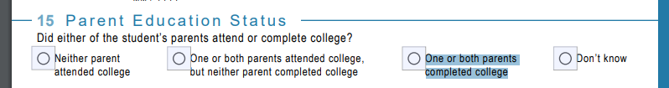
PARENT EDUCATION Information
IBHE Guidance on Sharing/Using Information Colelcted via FAFSA
https://www.ibhe.org/assets/files/iheis/2024/IBHE%20Guidance%20on%20Sharing%20FAFSA%20and%20Financial%20Aid%20Data.docx
New FAFSA Question 15 Responses:
1-Neither parent attended college
2-One or both parents attended college, but neither parent completed college
3-One or both parents completed college
4-Unknown

Slide 5
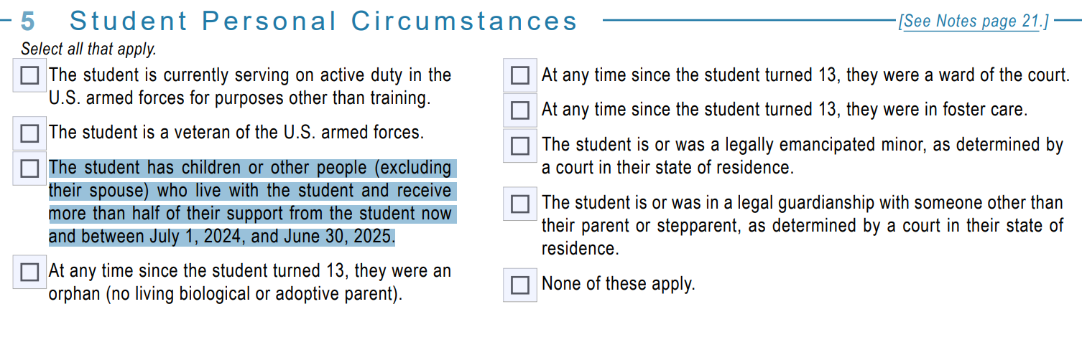
Parent Student
FAFSA Question 5/IHEIS Parent Student Column 102

Slide 6
MIDDLE Eastern/north african
Public Act 103-0414
Illinois General Assembly - Full Text of Public Act 103-0414
Adds Middle Eastern/North African as a standalone race/ethnicity category

Slide 7
Gender
Change fully implemented last year
  Gender of the student
  M = Male
  F = Female
  N = Unknown/Another Gender
IPEDS is implementing this change 2023-2024.
Gender Unknown or Another Gender than Provided
Categories
The 'gender unknown' category is to report students for whom the institution does not know a gender.
Institutions should not ask students who do not select a binary gender to allocate themselves to a binary gender category.

Slide 8
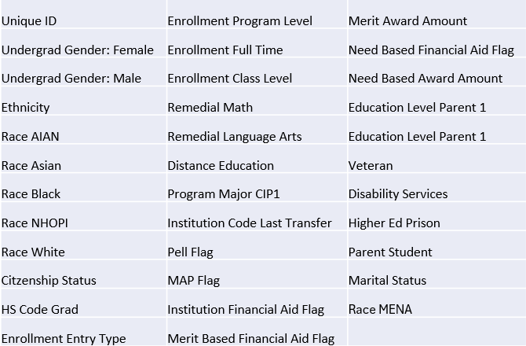
Data Quality Dashboard
  DQD improved so that it is more useful to users.
      Comparison to data from the previous year
      Delta of +/-20% or more will trigger User to verify.
Enrollment Audits

Slide 9
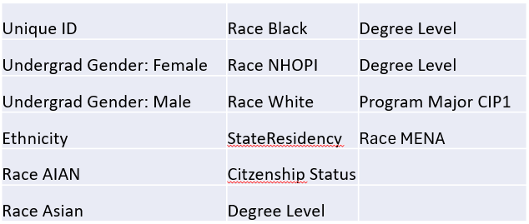
Data Quality Dashboard
  DQD improved so that it is more useful to users.
      Comparison to data from the previous year
      Delta of +/-20% or more will trigger User to verify.
Graduation Audits

Slide 10
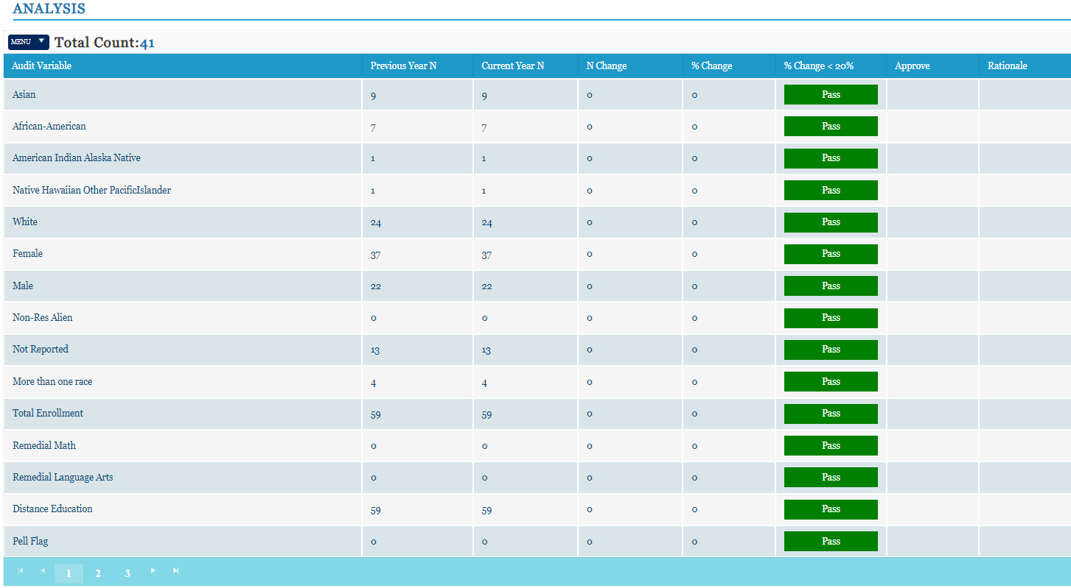
Data Quality Dashboard

Slide 11
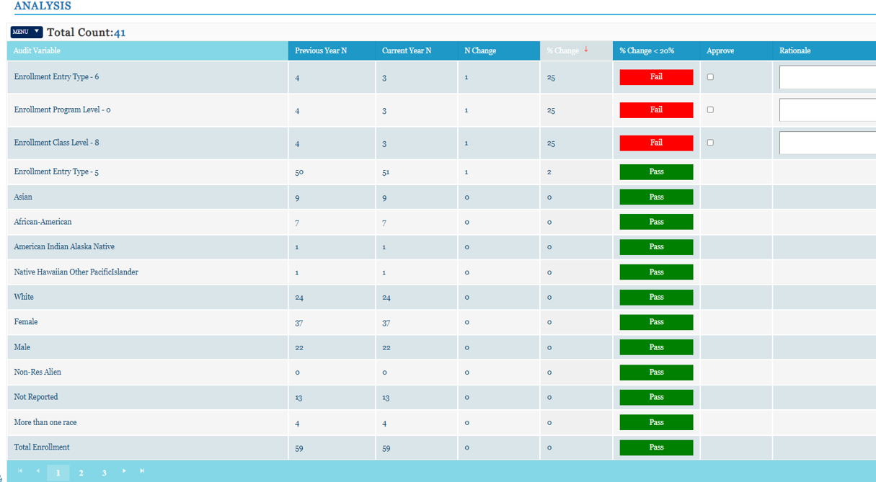
Data Quality Dashboard

