Slide 1

Illinois Higher Education Information System
IHEIS Webinar
December 12, 2023

Slide 2
IHEIS
2023-2024 Other Data Collections By IBHE IM&R
Data Collection | Open Date | Close Date
FES 1 Preliminary Fall Enrollment | September 7, 2023 | October 6, 2023
FES 1 Public University Additional Preliminary questions | September 7, 2023 | October 6, 2023
IBHE Program Inventory Updates for AY 2023-2024 | November 15, 2023 | Needs to be completed before CIP is submitted for enrollment or graduation.

Slide 3
IHEIS
2023-2024 Illinois Higher Education Information System
Data Collection | Open Date | Close Date
Fall Enrollment AY 2023-2024 | Monday, January 8, 2024 | Friday, March 15, 2024
Spring Enrollment AY 2023-2024 (include Winter Term if on Trimesters or Quarters) | Monday, May 13, 2024 | Friday, August 23, 2024
Summer Enrollment AY 2023-2024 | Monday, July 1, 2024 | Friday, October 4, 2023
Graduation FY (July 1 2023-June 30, 2024) | Monday, July 1, 2024 | Friday, October 4, 2024

Slide 4
Prison Location Information
A prison location table will be added to the collection.
A list of all available prisons will be put in the data dictionary with a unique ID for each location
For each record marked as having a student in prison, you will have to submit, in the enrollment file, a location ID for each enrollment.

Slide 5
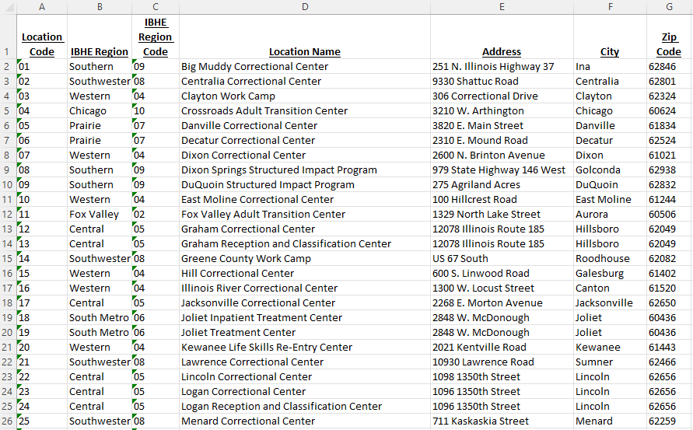
Prison Location Information

Slide 6
Student Parent Data Collection Act
Public Act 102-0088
https://www.ilga.gov/legislation/publicacts/fulltext.asp?Name=102-0088
Enrollment code denoting Y/N for Student Parent.
Required this year for Public Universities 2023-24
  Replaces Eric’s collection

Slide 7

Student Parent Data Collection Act
Marital Status will be added this year.
Required for Public Universities.
Used to primarily find out who is a single mom.
Question 16 on the FAFSA.
Select the answer that describes your marital status as of the day you submit your FAFSA form. If your marital status has changed or will change since the time the application was initially submitted, check with your college’s financial aid office.
“Married or remarried” doesn’t mean living together unless your state of legal residence recognizes the relationship as a common law marriage.
For FAFSA purposes, a married couple is separated if the couple is considered legally separated by a state or if the couple is legally married but has chosen to live separate lives, including living in separate households, as though they weren’t married. If you and your spouse are separated but living together, select “Married/Remarried,” not “Separated.”

Slide 8
Degree level error issue
Degree Level Error currently highlights three variables
  Degree level
  CIP
  Region
The goal is to highlight the variable that caused the error.

Slide 9
Gender
Change fully implemented last year
  Gender of the student
  M = Male
  F = Female
  N = Unknown/Another Gender
IPEDS is implementing this change 2023-2024.
Gender Unknown or Another Gender than Provided Categories
The 'gender unknown' category is to report students for whom the institution does not know a gender.
Institutions should not ask students who do not select a binary gender to allocate themselves to a binary gender category.

Slide 10
Data Quality Dashboard Improvements
  DQD will be improved so that it is more useful to users.
    Comparison to data from the previous year
    Delta of 15-20% or more will trigger User to verify.
  It will be implemented in the Spring during the Fall Collection.

