Slide 1

Illinois Fiscal Year 2021
Higher Education Budget Context
September 10, 2019

Slide 2


Illinois Fiscal Year 2021 Higher Education
Budget Context
Nyle Robinson
Interim Executive Director and
Deputy Director for Fiscal Affairs
and Budgeting

Slide 3
Historic Fiscal Year 2020 Budget
The best operations and capital budget in at least a generation

Slide 4
Illinois’ Fiscal Year 2020 Higher Education Operations Budget: Best Since at Least Fiscal Year 1990
Overall: Added $154.4 M in general funds, 8.2% increase, largest PERCENTAGE ever*
Universities: Added $52.8 M, 4.8% increase
  5% for general operations but not for special U of I and SIU grants
Community Colleges: Added $33.3 M, 12.3% increase
  4.9% increase for unrestricted grants
  $23.8 M for new competitive grant program
  $1 M for transitional math program
Adult Education: Added $1.9 M, 3.7% increase
  5% for base and performance grants, no increase for match to federal funding

Slide 5
Illinois’ Fiscal Year 2020 Higher Education Operations Budget: Best Since at Least Fiscal Year 1990
MAP: Added $50 M, a 12.5% increase and the largest appropriation ever.
AIM HIGH: Added $10 M to the new program, total $35 M, which must be matched by public universities that dispense grants to students based on merit-based criteria
ISAC Operations: Added $4 M to cover decline in federal loan servicing income
  Maintenance funding, not a net increase in services provided
Golden Apple Accelerators Program: $750 K for new program
Exonerated Persons Grants: $150 K for new program
Grow Your Own Grant: $1 M, 68.2% increase
Illinois Mathematics and Science Academy: Added $552 K, 3% increase

Slide 6
Rebuild Illinois Six-Year Capital Program
Program will be spread over six years
$3.2 B for public sector projects plus $400 M for private colleges and universities
$160.6 M CDB line item can be used for other state facilities as well
28.7% is reappropriated, mostly for projects funded originally in Fiscal Year 2010 but never completed
65.6% is for new projects, new construction
Many projects on the Fiscal Year 2019 capital emergency list remain and more projects have reached emergency status
Most new projects will take a number of years to complete
Funding of projects will compete with all other vertical capital projects over six years.
Rebuild Illinois Higher Education Funding
 | New Projects | Emergency & Cap. Renewal* | Total
Universities | $ 1,406,909.8 | $ 695,082.5 | $ 2,101,992.3
Community Colleges | $ 544,790.4 | $ 200,184.0 | $ 744,974.4
IMSA | $ 12,851.9 | $ 6,680.0 | $ 19,531.9
Statewide (CDB)* | $ - | $ 338,612.5 | $ 338,612.5
Private Col. & Univ. | $ 400,000.0 | $ - | $ 400,000.0
Total | $ 2,364,552.1 | $ 1,240,559.0 | $ 3,605,111.0
Reappropriation | $ 733,118.4 | $ 302,168.5 | $ 1,035,286.9
New Appropriations | $ 1,631,433.7 | $ 938,390.5 | $ 2,569,824.2
*Includes $160.6 M in CDB line not exclusive to higher education

Slide 7
Review of Illinois Higher Education Funding Fiscal Years 2002-2020
Recovery has only begun and there is a long way back

Slide 8
One Good Budget Does NOT Mean Recovery
Funding for higher education other than pensions peaked in Fiscal Year 2002 at $2.43 B, compared to $2.05 B for Fiscal Year 2020
  Fiscal Year 2020 8.2% increase beat the previous best of 7.8% in Fiscal Year 2002 but in dollar terms the Fiscal Year 2002 increase was $174.9 M compared to $154.5 M for Fiscal Year 2020
  Previous best since Fiscal Year 2002 was $2.3 in Fiscal Year 2007, the only year since Fiscal Year 2002 when new funding exceeded inflation.
  Four times since Fiscal Year 2002 funding decreased by more than 6%, including a 10% cut to universities and community colleges in Fiscal Year 2018
Greatest single impact came in Fiscal Year 2016
  A one-time hit of $1.2 B overall, mostly to universities and community colleges
Even with an excellent Fiscal Year 2020 budget, adjusted for inflation and unfunded mandates, the total higher education operations buying power for Fiscal Year 2020 is only 56.3% of what was received in Fiscal Year 2002
Worst impact has been on public universities
  Funding fell from $1.50 B in Fiscal Year 2002 to $1.16 B in Fiscal Year 2020
  Adjusted for CPI inflation and unfunded mandates Fiscal Year 2020 state appropriations buying power is only 49.8% of Fiscal Year 2002 and adjusted to the Higher Education Price Index it is only 44.5% of Fiscal Year 2002 buying power

Slide 10
Pension Liabilities Consume Available Resources
While funding for higher education operations declines steadily since Fiscal year 2002, funding for pensions (State University Retirement System) have increased sharply
Fiscal Year 2000 SURS General Revenues funding - $218.2 M
But historic underfunding of future pension costs caused the state’s liabilities to grow
To address the underfunding problem the General Assembly approved, back loaded, pension ramp requires escalating contributions through 2045
Fiscal Year 2020 SURS General Revenues appropriation - $1,644.1 M

Slide 11
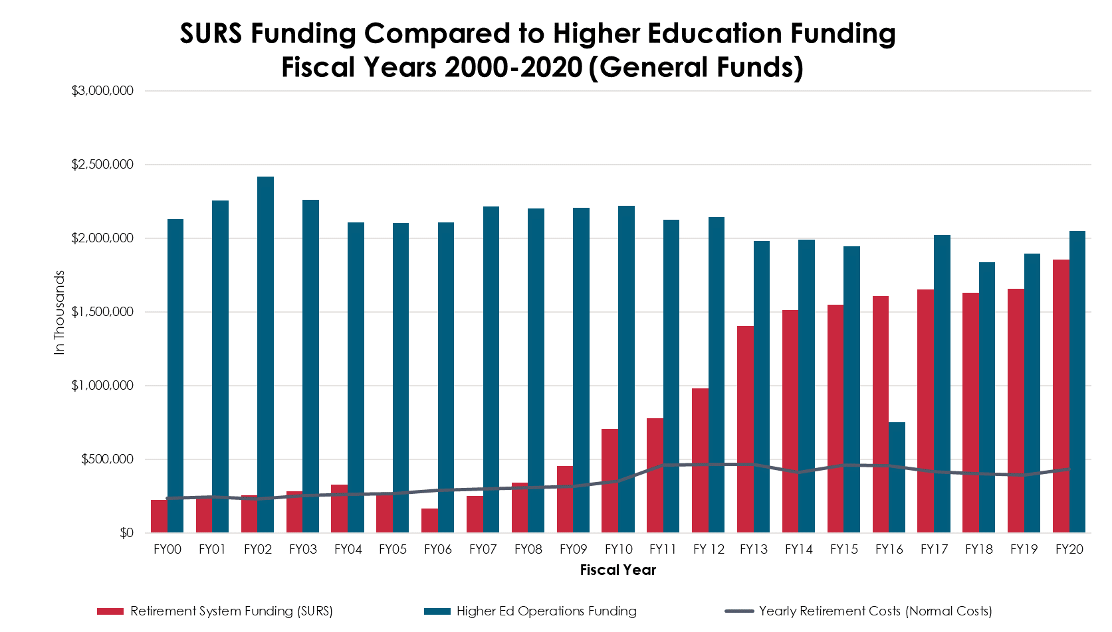
SURS Pension Liabilities vs. Higher Education Operations
While support for current higher education operations declined sharply since Fiscal Year 2002, there has been a 653% increase in SURS contributions from Fiscal Year 2000
The pressure of the pension ramp will continue well into the future
Contributions to cover current employees (normal costs) actually are declining each year

Slide 12
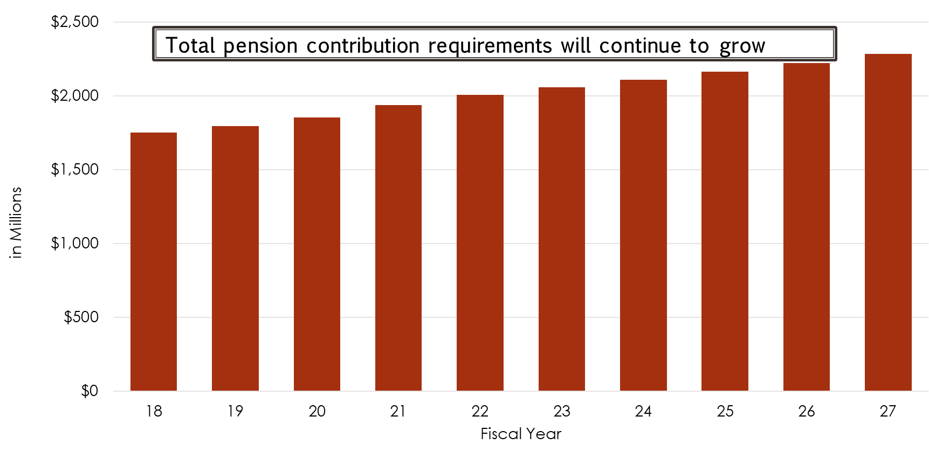
SURS Projected Total State Contributions
Fiscal Years 2018 - 2027

Slide 13
Pension Payments Increase but NOT for Current Liabilities
__________________________________________________________
Increasing pension payments are not for normal costs (current employees) but rather to cover unfunded past liabilities
Annual normal costs are generally declining as most new employees are moved to the less generous Tier 2 benefit package
Fiscal Year 2020 liabilities increase sharply due primarily to a change in actuarial assumptions and one-time savings from Fiscal Year 2019 not available in Fiscal Year 2020
NOTE: SURS will not issue new certified amounts for Fiscal Year 2020 or for Fiscal Year 2021 until October

Slide 14
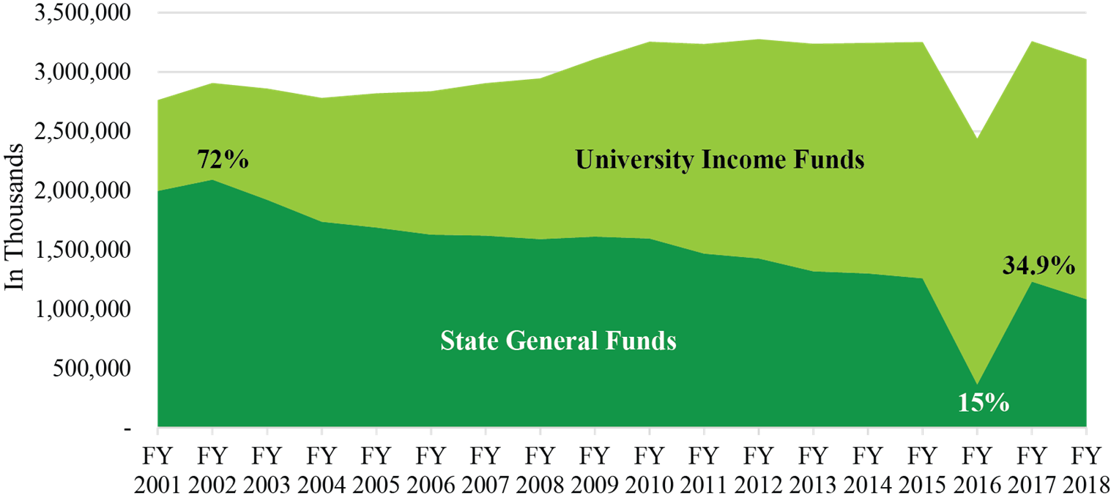
Falling State Support: Increased University Tuition and Fees
To make up for declining state support since Fiscal Year 2002, public universities and community colleges had to substantially increase tuition and fees
State dollars fell from 72% of support for universities in Fiscal Year 2002 to just 34.9% in Fiscal Year 2018
  NOTE: Fiscal Year 2018 spending is the most recently available data
  State funds covered just 14.5% of costs in Fiscal Year 2016
A decrease of more than 50%

Slide 15
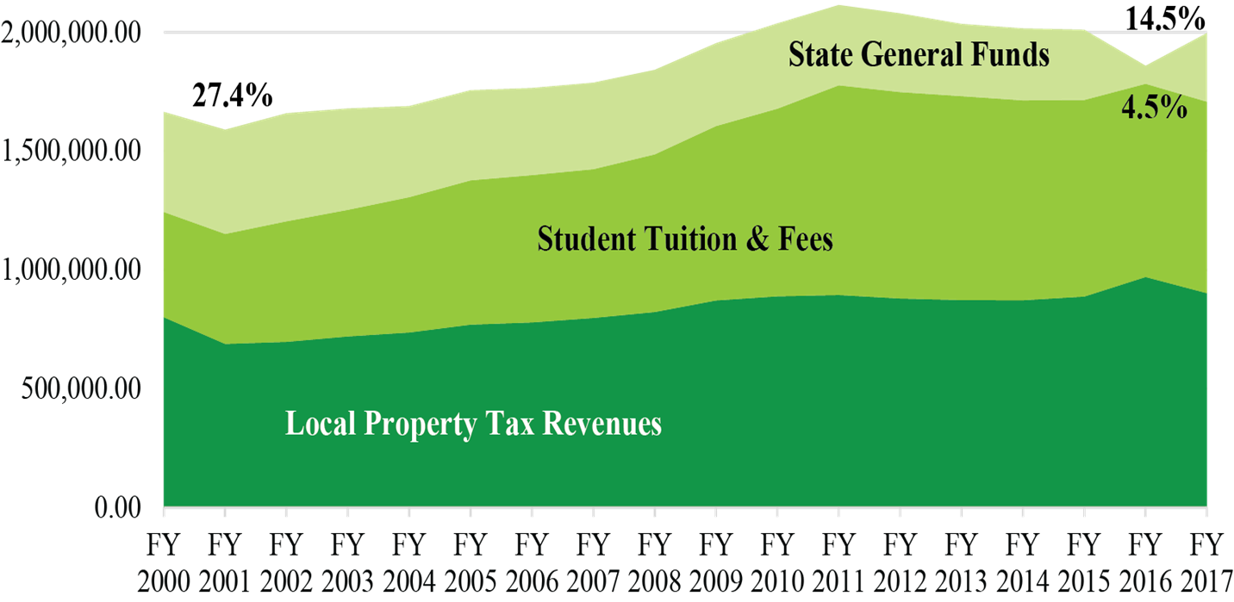
Falling State Support: Increased Community College Tuition and Fees and Property Taxes
Community colleges were established on the principle that state funds would cover 1/3 of their costs
  State funds fell short of that goal in Fiscal Year 2002 but still covered 27.4% of community college costs in Fiscal Year 2002
  State funds covered just 14.5% of community college costs in Fiscal Year 2016
  Declining state support for community colleges also resulted in increased dependence on property taxes since Fiscal Year 2002

Slide 16
Declining Monetary Award Program Coverage
Traditionally MAP covered 100% of the average weighted tuition and fees at public universities and community colleges and all applications deemed eligible
Despite the substantial increase in funding, ISAC indicates the maximum MAP grant will cover only 34% of average university tuition and fees in Fiscal Year 2020
The proportion of awards in suspension (unfunded) has increased significantly
Declining funding of MAP has been a contributing factor to out-of-state student migration and likely to many students choosing to not attend college at all

Slide 17
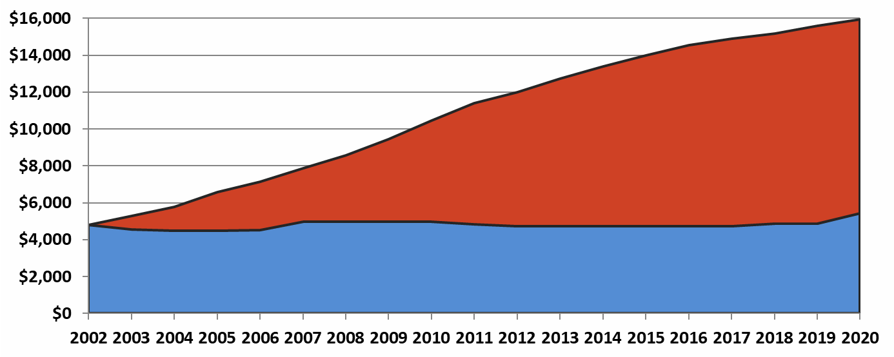
MAP’s Purchasing Power has Declined
In FY 2002, the maximum MAP grant covered 100% of Public University T&F.
Even with the improved FY 2020 MAP formula, only 34% will be covered.

Slide 18
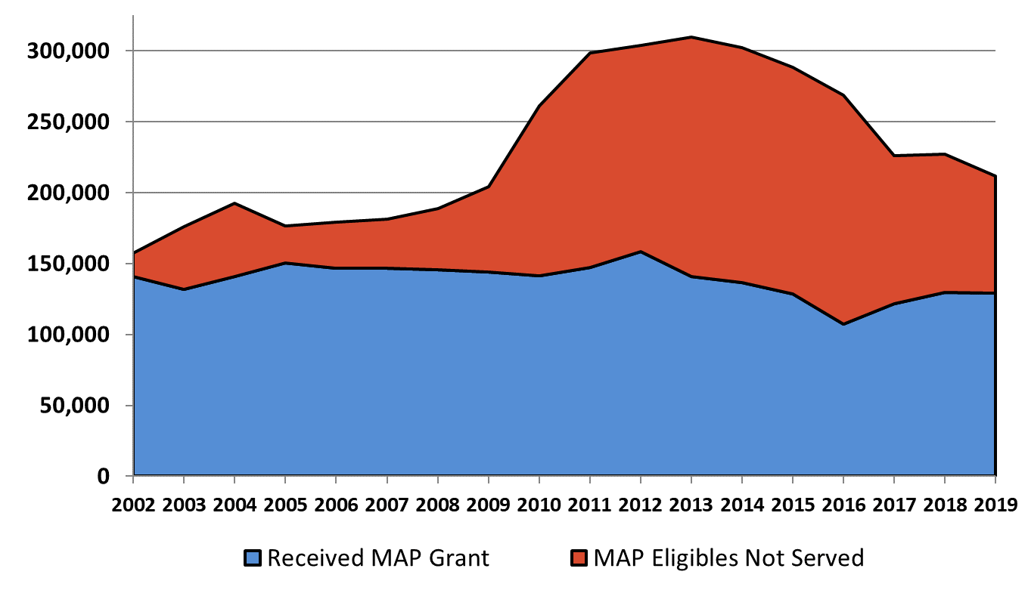
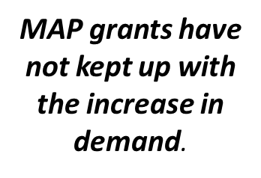
Demand for MAP Exceeds Supply

Slide 19
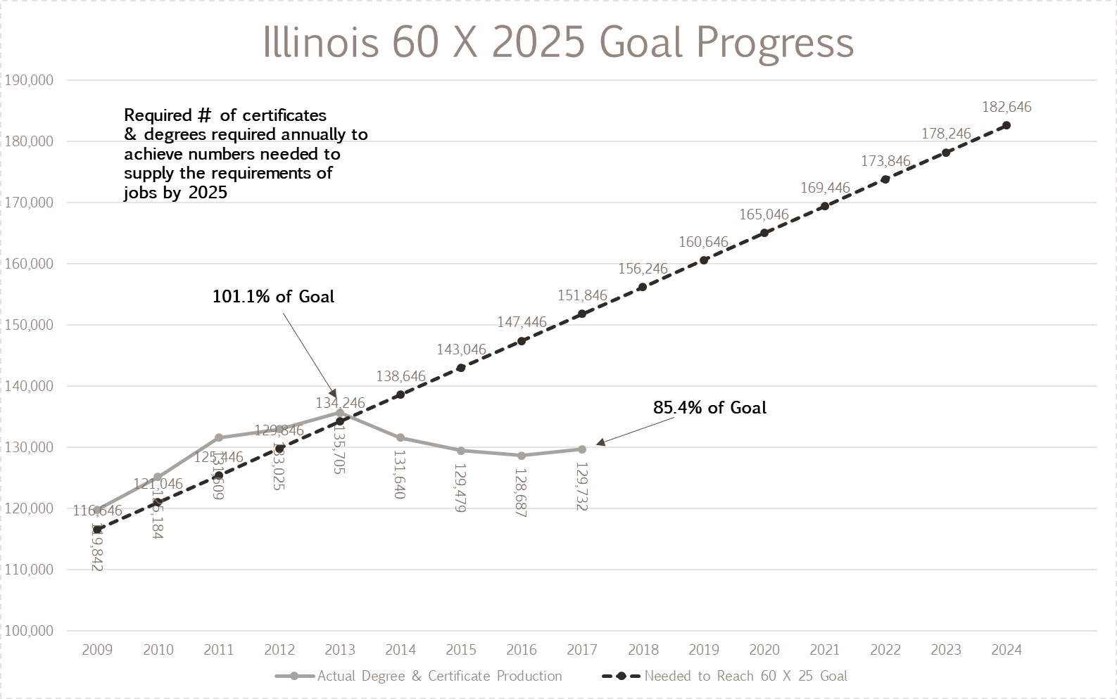
60 X 25: Failing to Meet the Needs of the Economy
The state goal is to have 60% of working residents hold a high-quality certificate or degree by 2025 because 60% of jobs will require such credentials by 2025
Since 2013 we have fallen progressively farther behind the goal, to just 85.4% in 2017, the most recent year for which there is complete data
Illinois started as a leader but has progressed more slowly than many other states
It is believed the budget impasse negatively impacted progress, including by increasing the proportion of students who start college outside of Illinois

Slide 20
Fiscal Year 2021 Budget Development Consideration

Slide 21
Fiscal Year 2021 Budget Possible Decision Rules:
Tie to K-12 Funding
Return to the rule that higher education should receive a dollar in new funding for every $2 in new funds K-12 receives
This was an unwritten rule until it was discarded by Governor Blagojevich
Since that time the actual ratio has increased from 2.5:1 to over 4.3:1
For Fiscal Year 2020, only 18.7% of education operations funding (excluding pension payments) went to higher education
  In Fiscal Year 2006, 25.6% of education operations funding went to higher education

Slide 22
Higher Ed’s Declining Share of Education Funding
Though the Fiscal Year 2020 budget was very good for higher education, the ratio was only 2.6:1
  K-12 received $396 M, exceeding the promised amount, while higher education received $154.5 M
Illinois has pledged to fully fund a K-12 needs-based formula at the rate of $375 M/year in new funds
An overall request following the 2:1 rule would give higher education an additional $187.5 M, substantially more than was received for Fiscal Year 2020

Slide 23
Fiscal Year 2021 Budget Possible Decision Rules:
Major Line Items
Soaring tuition costs present an increasing barrier to many students entering college and are most often cited as the reason students leave the state to start college elsewhere
  As state support has declined, universities have become highly dependent on tuition and fees
  It would take a 5.9% increase in general funds to provide flat funding without increasing tuitions, assuming flat enrollment
  While that is a larger percentage than universities received for Fiscal Year 2020, it would only provide 2.1% more funds than they received in Fiscal Year 2015 and it would be 18.4% less than they received in Fiscal Year 2002
Community colleges need a similar increase to help hold down tuition and fees, as well as local property taxes
The Governor has expressed an interest in supporting another $50 M for MAP
Additional funding is needed for AIM HIGH to expand it to cover a third year of eligible students
A return to funding for the Higher Education Cooperation Action (HECA) would help universities recover from the budget impasse and reimagine Illinois higher education system to reflect changes in society
Additional funding is needed for ISAC to maintain operations and outreach, covering declining federal revenues
IBHE has long championed restoring funding for veterans and National Guard tuition and fees, which is an unfunded mandate on universities and underfunded mandate for community colleges

Slide 24
Keeping Pace with Inflation: Flat Tuition or Flat State Funding
CPI Based on 3 Year Agerage CPI Increase
General Fund Increase Needed to Avoid Tuition Increases
 | $ Distribution | Increase | Net
Inflation | 100.0% | 2.06% | 102.06%
University Income Fund | 65.1% | 0.00% | 65.10%
State $ | 34.9% | 5.90% | 36.96%
Net |  |  | 102.06%
Needed to Maintain Buying Power with Flat General Funding *
 | $ Distribution | Increase | Net
Inflation | 100.0% | 2.06% | 102.06%
University Income Fund * | 65.1% | 3.16% | 67.16%
State $ | 34.9% | 0.00% | 34.90%
Net |  |  | 102.06%
* Reflects change in revenues but due to Truth in Tuition law, tuition increases can only be applied to new students. So, tuition increases would need to be significantly higher.

Slide 25
Capital Needs and Expectations
The Fiscal Year 2020 IBHE capital request included:
  $974 M in reappropriations, capital renewal and new projects
  $664 M for capital renewal
  $1,480 M for regular capital projects
  This reflected a great deal of pent-up demand
Rebuild Illinois includes the following over six years:
  $1,035 M in reappropriations, capital renewal and new projects
  $939 M for capital renewal
  $1,231 M for regular capital projects (public)
  $400 M for private colleges and universities
With a six-year plan in place, including revenues to support the spending, additional capital funding for Fiscal Year 2021 seems unlikely
However, there are significant needs remaining, particularly to address deferred maintenance problems

Slide 26
Growing Deferred Maintenance: Prior to Fiscal Year 2020
Deferred maintenance has been a growing problem for community colleges and universities
Deferred maintenance at universities and community colleges increased from $2.7 B in Fiscal Year 2005 to almost $6.2 B in Fiscal Year 2019
No capital funding during this period other than Illinois JobsNow!
  Most Fiscal Year 2010 projects never released, included in Rebuild Illinois

Slide 27
Public University Capital Renewal:
Annual Investment Needed
30.9% of the $24.5 B in university facilities are not supported by state funds
To keep up with a 50-year replacement cycle for facilities 2% of the replacement cost should be invested each year in capital renewal, $338.5 M
If an additional 1% of replacement cost was invested each year it would take 30.9 years to catch-up, $169.3 M
3% total for universities, $507.8 M
Table excludes IMSA, UCLC and community colleges
Rebuild Illinois likely will fund universities at about 1% of replacement costs
Even with Rebuild Illinois, institutions will need to continue to use operations funds to limit increases in deferred maintenance
Public University Capital Analysis: FY 19 *
Total Square Feet | 71,739,730
Avg. $/Square Foot | $ 341.26
Total Value of University Facilities | $ 24,481,575,213
State Supported Square Feet | 49,466,618
Avg. $/Square Foot | $ 342.18
Est. Value of State Supported Fac. | $ 16,926,246,303
2% Current Capital Renewal | $ 338,525,000
1% Catch-up Funding | $ 169,262,500
3% Capital Renewal Request | $ 507,787,500
FY 19 Deferred Maintenance | $ 5,229,723,000
Est. Years to Recovery @1% | 30.9
Non-State Supported Facilities | 22,273,111
Avg. $/Square Foot | $ 339.21
Est. Value of Non-State Supported | $ 7,555,328,910
% Non-State Supported Facilities | 30.9%
* Excludes IMSA & UCLC

Slide 28

Questions and Discussion
This overview of the current budget and budget trends from Fiscal Year 2000 to Fiscal Year 2020 is intended to help set the table for development of the Fiscal Year 2021 Higher Education budget recommendations from the Board to the Governor and the General Assembly.

Slide 29


