Slide 1
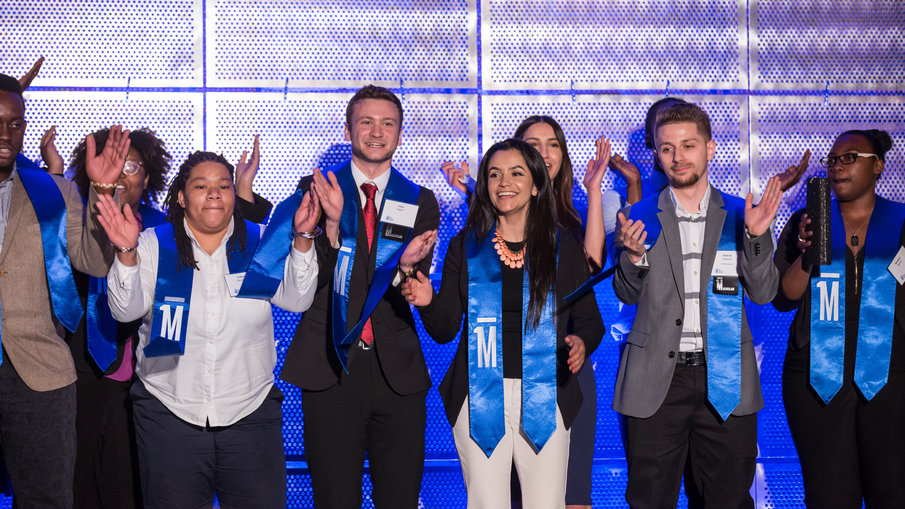

One Million Degrees
Highlights from the Randomized Controlled Trial
Presentation to the Illinois Board of Higher Education
September 10, 2019
Notes:
Goal and Objectives
Share new findings from the One Million Degrees RCT
Discuss how to translate the lessons from research into practice

Slide 2
Interim findings show OMD is encouraging college enrollment and persistence
Participating in the One Million Degrees program led to large and statistically significant increases in:
  Enrollment in college
  Enrolling with a full-time courseload
  Persisting by enrolling in both fall and spring
  Persisting full-time by enrolling in both fall and spring
Participating in OMD also leads to significant increases in credits attempted and credits earned
The impacts are largest for scholars who are recruited to enroll in the program right after high school

Slide 3
Community colleges can be engines of social mobility, but many students face barriers
Open-access and affordable; attractive to many first-generation, low-income, and non-traditional students
Earning an associate’s degree can increase a family’s lifetime earnings by 30%
While completion rates are rising, two thirds of aspiring community college students will not finish their degree within three years
Interventions targeting a single barrier facing students have not been as successful as wraparound models with proactive advising
Sources: City Colleges, 2018; Long, 2014; Matorell & McFarlain, 2011; Scrivener & Weiss, 2009; Evans, Kearney, Perry, & Sullivan, 2017; Scrivener et al. 2015.

Slide 4
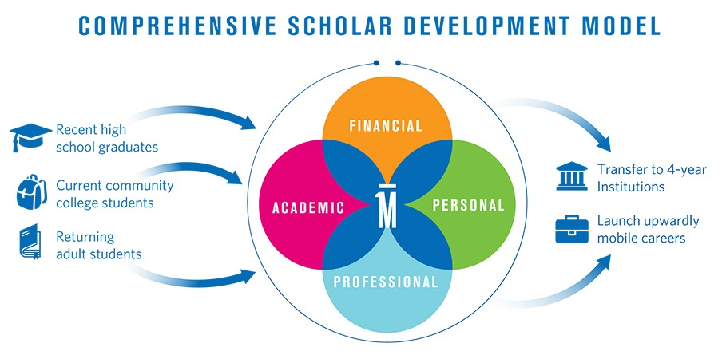
OMD provides comprehensive and targeted support to low-income two-year college students

Slide 5

OMD accelerates scholars’ progress and mitigates challenges on their path to a degree
ACCELERATORS
an asset-based approach, building social capital, vision, and self-efficacy
Dedicated volunteer coaches (working or retired professionals) help build and bridge social capital and offer windows into the professional world
Monthly professional development workshops build skills and networks for the future and a support community for the college experience
Program expectations on the Do Your PART rubric promote leadership, communication, and engagement
Enrichment grants defray the costs of licensure exams, honor society fees, equipment, and conferences
The OMD Scholar Journey through community college
Transition from high school
Graduation and transition to next steps
Recruitment outreach promoting OMD as a community of support and an opportunity to belong inspires action; regular nudging and accountability helps students get through the enrollment and financial aid process
Full-time, dedicated success coaches closely track course completion, GPA, registration, financial aid, and overall attendance and engagement
Tutors meet weekly with students who are struggling in their courses
The Do Your PART rubric provides clarity of expectations, transparency around performance, and prompts specific goals for improvement
Performance-based financial incentives provide needed funding for books, childcare, transportation
MITIGATORS
a highly supportive, authentically caring approach addressing barriers

Slide 6
OMD has changed my expectations for myself by showing me that I can do a lot more than I thought I could. Every student has the potential to be whatever they want to be, they just don’t see it.
What One Million Degrees does is help them see it by surrounding them with other students who also feel the same way and bringing out the best in them…and showing them that they could do whatever they want to do.”
- Luis, current OMD Scholar at Harold Washington College
“

Slide 7

We are able to measure the causal effect of OMD through a randomized controlled trial
TOTAL ELIGIBLE
POPULATION
(OMD Applicants)
TREATMENT (OMD Scholars) AND CONTROL GROUPS
MEASURING OUTCOMES
Outcomes, such as enrollment, persistence, and graduation, are tracked among both groups in order to understand the impact of OMD.
There are more students eligible for OMD than there are program slots.
Eligible applicants are randomly assigned to receive the program or not.

Slide 8



We have randomized several cohorts of students with a long-term focus on graduation or transfer
Cohort 1
Primary Outcomes of Interest
Three-year graduation OR enrollment in Bachelor program
Secondary Outcomes of Interest
Predictors of graduation: enrollment, full-time enrollment, rate of persistence, credits earned, use of college services, and GPA
Graduation from a Bachelor’s Degree program
Labor market outcomes (e.g., employment and wages)
Spring 2016
1,452 applicants
Cohort 2
Spring 2017
2,822 applicants
We prioritize using administrative data to analyze outcomes for both control and treatment group applicants

Slide 9
OMD applicants are predominantly students of color, many of whom are first-gen & Pell-eligible
Race/ethnicity | OMD Control | OMD Treatment |  | Other Characteristics | OMD Control | OMD Treatment
Black | 37% | 40% |  | Female | 60% | 60%
Hispanic | 48% | 45% |  | Married | 3% | 3%
White | 5% | 6% |  | Single | 93% | 92%
Asian | 5% | 5% |  | Divorced | 1% | 2%
Multiracial | 3% | 2% |  | US Citizen | 86% | 86%
Native American | 0.3% | 0.4% |  | Veteran | 2% | 3%
Other | 1% | 1% |  | First gen college | 61% | 59%
 |  |  |  | Pell-eligible | 68% | 69%
 |  |  |  | Chicago Star | 40% | 37%
N | 2,099 | 2,175 |  | Age | 20.1 | 21.1

Slide 10
Approximately one-third of students offered a spot in OMD took up the offer to join the program
Since take-up was imperfect, we share estimates using two different measures:
34% take-up
ITT
(“Policy Impact”)
  ITT Definition: The average effect among all applicants who were offered a spot in OMD
  Policy impact: What would be the effect of offering the program to more students?
TOT
(“Program Impact”)
  TOT Definition: The average effect among those who actually enrolled in OMD, and those who would have enrolled if offered a spot
  Program impact: What is the effect of the program for those that are served?

Slide 11
OMD has a positive effect on enrolling in college
For students offered OMD…
For students participating in OMD…
23% increase**
27% increase**
7% increase**
9% increase***
N = 4,257 * p<0.05 ** p<0.01 *** p<0.001
Data source: National Student Clearinghouse

Slide 12
OMD also has a strong effect on enrolling with a full-time courseload
For students offered OMD…
For students participating in OMD…
35% increase***
35% increase***
13% increase***
13% increase***
N = 4,257 * p<0.05 ** p<0.01 *** p<0.001
Data source: National Student Clearinghouse

Slide 13
OMD also has a positive effect on both persistence and persisting full-time
For students offered OMD…
For students participating in OMD…
35% increase***
11% increase***
16% increase***
N = 4,257. Persistence is defined as enrolling in both fall and spring semester during the school year. Full-time persistence is defined as enrolling both semesters with a full-time course load. Data source: National Student Clearinghouse
* p<0.05 ** p<0.01 *** p<0.001

Slide 14
OMD applicants include graduating high school seniors and current community college students
When recruiting the second study cohort, OMD significantly increased outreach to high schools
Interested students applied to the program in spring of their senior year
The majority of the study sample (60%) were high school seniors at time of application
This allows us to examine the impact of the program on high school applicants specifically

Slide 15
The offer of a spot in OMD has a similar effect across the two groups
11% increase**
7% increase*
13% increase**
14% increase***
8% increase†
16% increase**
16% increase**
11% increase†
19% increase***
N = 2,534
N =1,723
Data source: National Student Clearinghouse

Slide 16
The effect for participants, however, is significantly larger for high school students
73% increase***
14% increase*
92% increase**
100% increase***
82% increase**
15% increase†
85% increase***
104% increase***
15% increase†
21% increase†
N = 2,534
Data source: National Student Clearinghouse
N =1,723

Slide 17
We find that OMD is incentivizing HS students to attend college who may not have attended at all
When looking at college enrollment patterns for high school applicants, we find that about one-third did not enroll in any college in the fall following their application
For students who received an offer to join OMD, they were more likely to enroll in the school indicated on their application (City College or Harper)
A small share of students who received the OMD offer appear to have switched from another college to an OMD-college
N = 2534
Source: National Student Clearinghouse

Slide 18
Evidence is building that holistic supports improve outcomes for CC students
Common elements of successful programs:
  Financial support, whether access to an emergency fund, reduced-price tuition, or performance-based stipends
  Reliable interpersonal support, whether structured mentoring, coaching, or individualized advising
  Technology and data infrastructure to support staff with managing students’ needs and right-sizing
  Concerted efforts to cultivate a sense of belonging and community

Slide 19






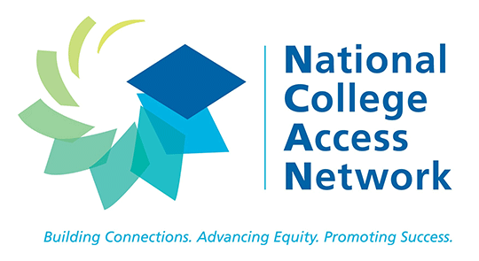
We are engaging with research and educational peers to inform future analyses and replication
We have presented campus-level results with CCC’s Chancellor, Provost, and college presidents
We also shared high school findings with CPS leadership
We will be presenting at several national conferences
We continue to engage external peers to understand the opportunities and challenges associated with scaling

Slide 20
Thank you

Slide 21
The study will continue through 2023, with long-term analyses on graduation and employment
2017
2016
2017
2018
2019
2020
2021
2022
2023
Cohort 1 in school
Fall 2016 – Spring 2019
Cohort 2 in school
Fall 2017 – Spring 2020
Cohort 3 in school
Fall 2018 – Spring 2021
C1 graduation analyses completed
Winter ‘20
Winter ‘21
C2 graduation analyses completed
C3 and combined cohort graduation analyses completed
Winter ‘22
C1 enters labor market or four-year institutions
Fall 2019 – Fall 2021
C2 enters labor market or four-year institutions
Fall 2020 – Fall 2022
C2 enters labor market or four-year institutions
Fall 2021 – Fall 2023
Labor market outcomes (dependent on IDES data acquisition)
Spring 2020 +

Slide 22

The Poverty Lab works to expand economic opportunity for residents of all communities
Our approach seeks to co-generate
evidence with public and non-profit partners
Our work cuts across
traditional policy domains
HOMELESSNESS
Household Finance
IDENTIFY
Promising strategies to support upward mobility
TEST
The most promising policies and programs
SCALE UP
The most effective and cost-efficient policies and programs
College Access and Success
Workforce
development

Slide 23
OMD boosts enrollment in CCC, especially among HS applicants unlikely to attend college
Confidential; please do not share
For HS students offered OMD…
For HS students participating in OMD…
HS N intending CCC = 2,333 HS N intending CCC and taker of OMD = 172
Data source: National Student Clearinghouse, City Colleges of Chicago

